Slide 1


Twitter Bot with NodeJS
A presentation by Sean O’Mahoney

Slide 2
What is NodeJS?
NodeJS is a JavaScript runtime, you can type in JavaScript
“Node is designed to build scalable network applications”
Async…

Slide 3
Setting up NodeJS
NodeJS is installed on the Uni Machines, under the Campus Applications then under a “NodeJS” folder (not the “documentation” or “website”)
Although it is free to install on your laptop/machine (with all programs mentioned in this presentation), by simply following the link - https://nodejs.org/en/download/

Slide 4
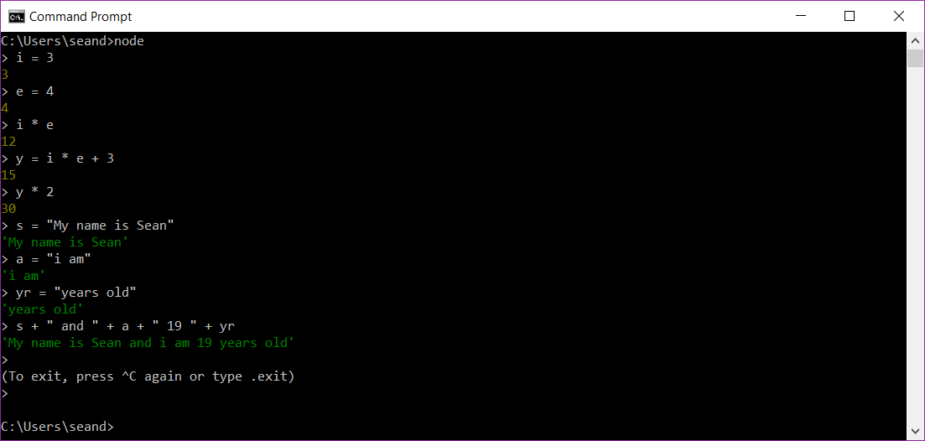
Quick Demonstration

Slide 5
Setting up a Project / Creating a File
Create a new folder on our Desktop called “NodeJS Twitter Bot”
On Uni machines, copy the file directory location, then with NodeJS open, type “cd ” then paste (changing the directory to the folder on our desktop)
On your laptop/machine (without restrictions), you can type “cmd” on the file directory location to open a command prompt accessing that area
From there we will type “npm init” (Node Package Manager - Initiate)
Once we have done that, we will then create a .js file in that folder
Open up this JavaScript file in an editor, personally I use Brackets (with the “Monokai Dark Soda” theme and various plug-ins)

Slide 6
Importing Libraries
You can search for packages/libraries on the Node Package Manager site https://www.npmjs.com/
“npm install x” (x is the library you will use for your project, twit, being for this)

Slide 7
Using a Library (twit)
“var x = require(‘y’);”
“x” being what you define for the use of the library
“y” being the predefined name of the library
“var Twit = require(‘twit’);”
“var z = new x()”
“z” being a new object of the library type
“x” being the library variable defined above
“var T = new Twit()”
Next we will discuses the paraments of the “new Twit()”, being an object with 4 properties

Slide 8
Creating a Twit Instance
We will replace these dots with the keys we will gain later on:
var Twit = require('twit')
var T = new Twit({
consumer_key: '...',
consumer_secret: '...',
access_token: '...',
access_token_secret: '...‘,
})

Slide 9
Hiding Keys
The “require” statement is not only used for Libraries', it can also be used to import files.
Create a new js file in the same directory and name it “keys.js”
Now open it in your text editor and place your keys in there, like this:
module.exports = {
consumer_key: ‘…',
consumer_secret: ‘…',
access_token: ‘…',
access_token_secret: ‘...',
}

Slide 10
Hiding Keys (Part 2)
We will now create another requires statement, but this time it won’t be in the default “node_modules” folder, so we have to go up a directory (using “./”), then specify the file (not having to include the “.js”).
var Keys = require('./keys');
Now we can replace the object in the creation of an instance, like so:
var T = new Twit(Keys);

Slide 11
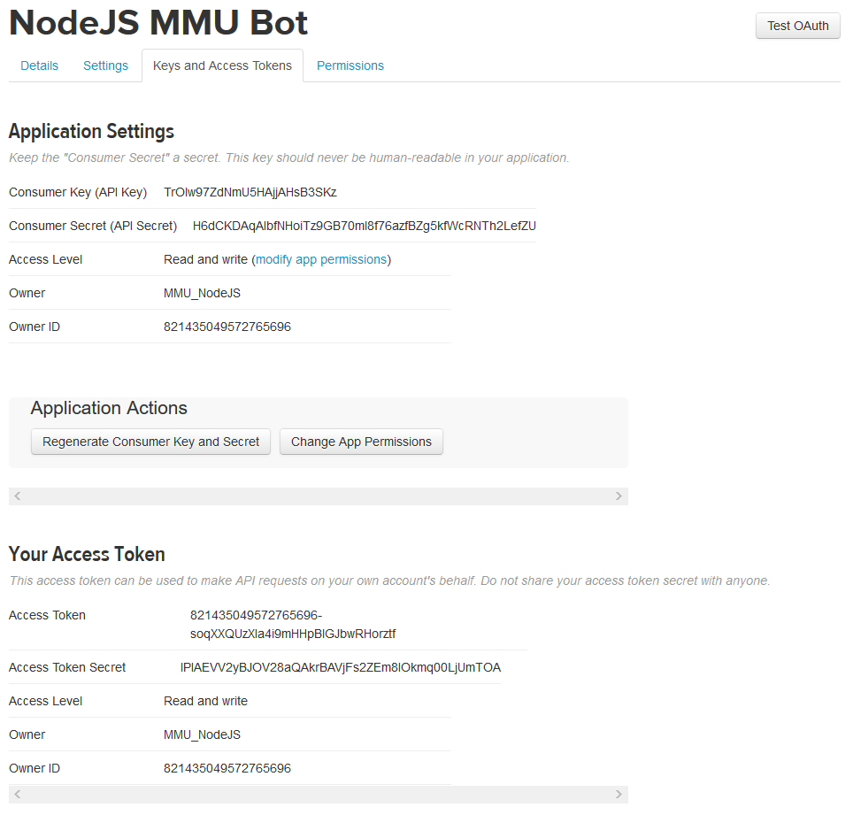
Twitter Keys (API)
To use twit, we will need to pass through 4 keys in the object, needed for the API (Application Program Interface).
Create or Log In to your Twitter Account
Ensure there is a mobile number associated with your account
Then go to https://apps.twitter.com/
Create a new app
Go to “Keys and Access Tokens”
Generate Your Access Token
“Regenerate My Access Token and Token Secret”

Slide 12
Twit Functions
There are 3 main functions in the Twit Library:
Post
Get
Stream
The first two have these arguments:
T.y(‘type', { object }, function(err, data, response) { //y being post/get
Code //console.log(data)
})

Slide 13
Posting a Tweet (.post)
We will now use that “T” twit instance we created, to simply post to the Twitter account
To achieve this, we will use the “post” function specified in the documentation
This will use the “statuses/update” type, have an object which contains the status, then the returned values from the function.
Then we’ll simply show what was pushed to Twitter on the console.
T.post('statuses/update', { status: 'hello world!' }, function(err, data, response) {
console.log(data)
})

Slide 14
Repetition
We will first call our function when we run our code, then it will run again on an interval, we first define which function we want to run, then specify the time (being in milliseconds), setting it to 1000, will run it every second.
process();
setInterval(process,1000*5); //5 Seconds
function process() {
//Code
}

Slide 15
Searching Tweets (.get) – References
If we wish, we can search for tweets similar to how we would with the search bar, using the code below, where “q” is our query (search terms).
T.get('search/tweets', { q: '#CodingRainbow', count: 10 }, function(err, data, response) {
console.log(data.statuses)
})

Slide 16
Like/Retweet (.stream)
var stream = T.stream('statuses/filter', { track: '#MMUNodeJSDemo' })
stream.on('tweet', gotTweet);
function gotTweet(tweet) {
console.log('Retweeting ' + tweet.id_str + ": " + tweet.text);
T.post('favorites/create', { id: tweet.id_str }, retweeted); //Likes
T.post('statuses/retweet', { id: tweet.id_str }, retweeted); //Retweets
function retweeted(err, data, response) {
if (err) { console.log("Error: " + err.message); } else { console.log('Retweeted: ' + tweet.id); }
}
}

Slide 17
Followers (.stream)
var stream = T.stream('user');
stream.on('follow', followed);
function followed(eventMsg) {
var name = eventMsg.source.name;
var screenName = eventMsg.source.screen_name;
T.post('statuses/update', { status: 'Thank you ' + '@' + screenName + ', for the follow!' }, tweeted);
function tweeted(err, data, response) {
if (err) { console.log(err); } else { console.log('Success: ' + data.text) }
}
}

Slide 18
Thank You! - Any Questions?
Sean O'Mahoney
Email: sean.omahoney@stu.mmu.ac.uk
LinkedIn: https://uk.linkedin.com/in/sean12697
ePortfolio: https://seanomahoney.me/
GitHub Repo’ for Examples: https://github.com/Sean12697/TwitNodeJS
Computing Society
Facebook: “MMUComputingSociety”
Twitter: @MMUCompSoc
Union: Computing Society
Resource's
NodeJS (REQUIRED): https://nodejs.org/en/download/
Brackets (Preferred Text Editor): http://brackets.io/
NPM (Node Package Manager Search): https://www.npmjs.com/

Slide 19
Deployment
Lets imagine we want our code to constantly be running or used as a service, we cannot have the script always running on our machine, which might be off, offline or just not available to use to run the script/s.
To combat this we will have to upload it to a server, for it to be ran, to do this, we will use a service called Heroku.

Slide 20
Heroku Setup
Firstly, we will want to set up an account here - https://www.heroku.com/
Then we will want to install the toolbelt from the following link - https://devcenter.heroku.com/articles/heroku-cli#download-and-install
Once that is installed, we will set it up to connect to our account, we will run the following command in a command prompt and login (with the credentials we have just created):
heroku login
Finally, we will want to install GitHub (as well as login or create an account), to push the project files - https://desktop.github.com/

Slide 21
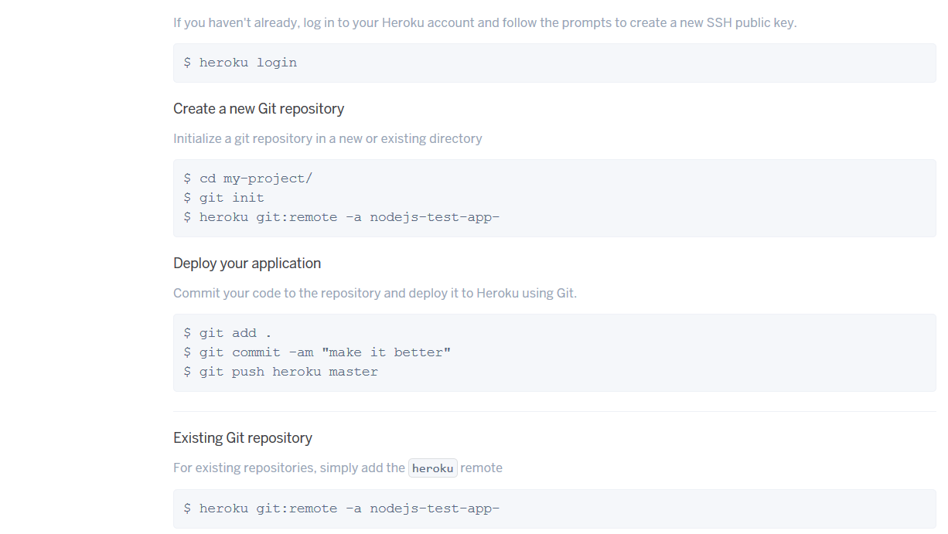
Heroku Deployment (GitHub)
From here we can go to the following link and create a new app - https://dashboard.heroku.com/apps
Then, before we upload it, we want to create a new file in our project called “Procfile” (no extension, not “Procfile.js”), with the single line of “worker: node script.js”, where the “script.js” is the file you want to execute.
Once we have done all that, we can finally upload it, to do this, we will enter the commands showed in the deploy section of the app, from where our project file is (containing the scripts, procfile, keys, node_modules folder and so on).

Slide 22
Thank You! - Any Questions?
Sean O'Mahoney
Email: sean.omahoney@stu.mmu.ac.uk
LinkedIn: https://uk.linkedin.com/in/sean12697
ePortfolio: https://seanomahoney.me/
Computing Society
Facebook: “MMUComputingSociety”
Twitter: @MMUCompSoc
Union: Computing Society
Extra Resource's
Heroku Toolbelt: https://devcenter.heroku.com/articles/heroku-cli#download-and-install
GitHub: https://desktop.github.com/

